Slide 1
MyCheapFriend.com
By
The CheapSkates
with
Waseem Ilahi and Shaoqing Neu as Double Trouble
And
Michael Glass and Huning “David” Dai as Dynamic Duo

Slide 2

Are You a Generous Friend?
Will your friends really buy the next round?
How long has she owed you $5?
Do you even remember who owes you a few bucks?

Slide 3
Becoming a Cheap Friend
With MyCheapFriend.com, you can finally
remember lending somebody a few bucks.
First: Send a text message to new_account@mycheapfriend.com
It will respond with a randomly generated e-mail address. Save it in your address book.

Slide 4
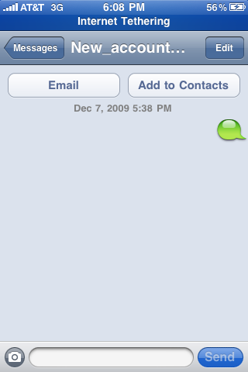
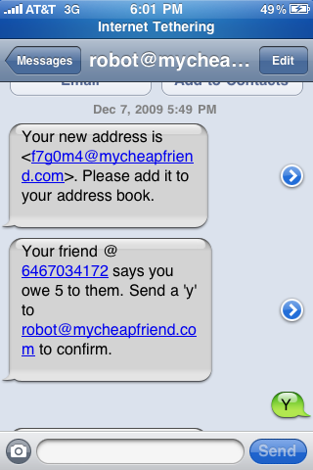

Slide 5
The Rules of the Game
For all of the following operations, send your message to your saved address.
Loan a few bucks
Send a message with a phone number and an amount less than $9999.99
For example: “6462294051 15”

Slide 6
Phone Numbers are Long
Texting long numbers is tedious. Give your friends nicknames.
Send a message with a nickname and a phone# We’ll remember it for you.
For example: “boss 2039804107”
Now you can use the nickname in place of a phone number
For Example: “Boss 7”

Slide 7
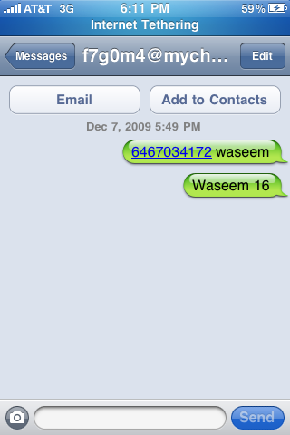
I give Waseem a nickname and
bill him $16
(actually I’m just paying him back)

Slide 8
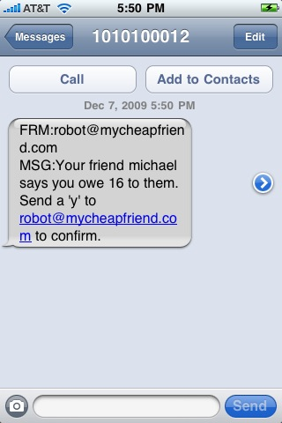
He receives (and accepts)my bill

Slide 9
So, how much do they owe me?
Send us a message containing the body, “Report”. We’ll tell you how much you owe, and how much is owed to you.

Slide 10
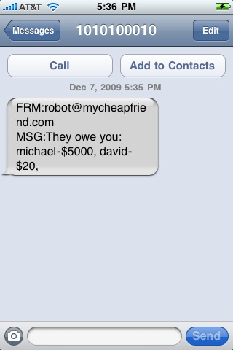
When we started, I owed Waseem
a ton of cash ☹

Slide 11
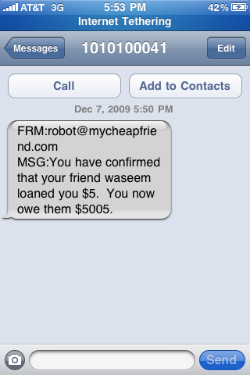
And yet,
he still lent me another $5

Slide 12
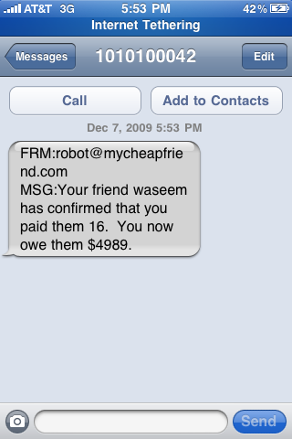
At least I paid him back something…

Slide 13
address@mycheapfriend.com | action
new_account | Create a new account, gives a new password
Reset_pass | Gives a new password
Unsubscribe | Stops all contact from us
resubscribe | Resumes contact from us
Action | Example message(s) (to: your secret address)
New bill | “6462294051 15.50” “Jon 13”
Multiple new bills | “6462294051 15.50 jon 13”
Splitting a bill | “25.50 6462294051 jon me”
New nickname | “jon 2039804107”

